Slide 1
Social Inclusion
Here is where your presentation begins

Slide 2
Contents of This Template
Here’s what you’ll find in this Slidesgo template:
A slide structure based on a project proposal, which you can easily adapt to your needs. For more info on how to edit the template, please visit Slidesgo School or read our FAQs.
An assortment of illustrations that are suitable for use in the presentation can be found in the alternative resources slide.
A thanks slide, which you must keep so that proper credits for our design are given.
A resources slide, where you’ll find links to all the elements used in the template.
Instructions for use.
Final slides with:
The fonts and colors used in the template.
A selection of illustrations. You can also customize and animate them as you wish with the online editor. Visit Stories by Freepik to find more.
More infographic resources, whose size and color can be edited.
Sets of customizable icons of the following themes: general, business, avatar, creative process, education, help & support, medical, nature, performing arts, SEO & marketing, and teamwork.
You can delete this slide when you’re done editing the presentation.

Slide 3
Table of Contents
01
04
02
05
03
06
About the Project
Sneak Peek
Here you could describe the topic of the section
Here you could describe the topic of the section
Major Requirements
Project Stages
Here you could describe the topic of the section
Here you could describe the topic of the section
Project Goals
Our Team
Here you could describe the topic of the section
Here you could describe the topic of the section

Slide 4
Awesome Words

Slide 5
Our Company
Mercury is the closest planet to the Sun and the smallest one in the Solar System—it’s only a bit larger than the Moon

Slide 6
What We Are Working On
Retail
Residential
Hospitality
Despite being red, Mars is actually a cold place
Jupiter is a gas giant and the biggest planet
Yes, Saturn is the ringed one. It’s a gas giant

Slide 7
Occupation Area
Jupiter
Jupiter is a gas giant
Neptune
It’s the farthest planet

Slide 8
About the Project
Mercury is the closest planet to the Sun and the smallest one in the Solar System—it’s only a bit larger than the Moon

Slide 9
Someone Famous
“
“This is a quote, words full of wisdom that someone important said and can make the reader get inspired.”

Slide 10
Now
Venus has a beautiful name and is the second planet from the Sun. It’s terribly hot—even hotter than Mercury

Slide 11
Future
Mercury is the closest planet to the Sun and the smallest one in the Solar System—it’s only a bit larger than the Moon

Slide 12
Major Requirements
Mars
Jupiter
Saturn
Despite being red, Mars is actually a cold place
Jupiter is a gas giant and the biggest planet
Yes, Saturn is the ringed one. It’s a gas giant
Venus
Neptune
Mercury
Venus has a beautiful name, but it’s terribly hot
It’s the farthest planet
From the Sun
Mercury is the closest planet to the Sun

Slide 13
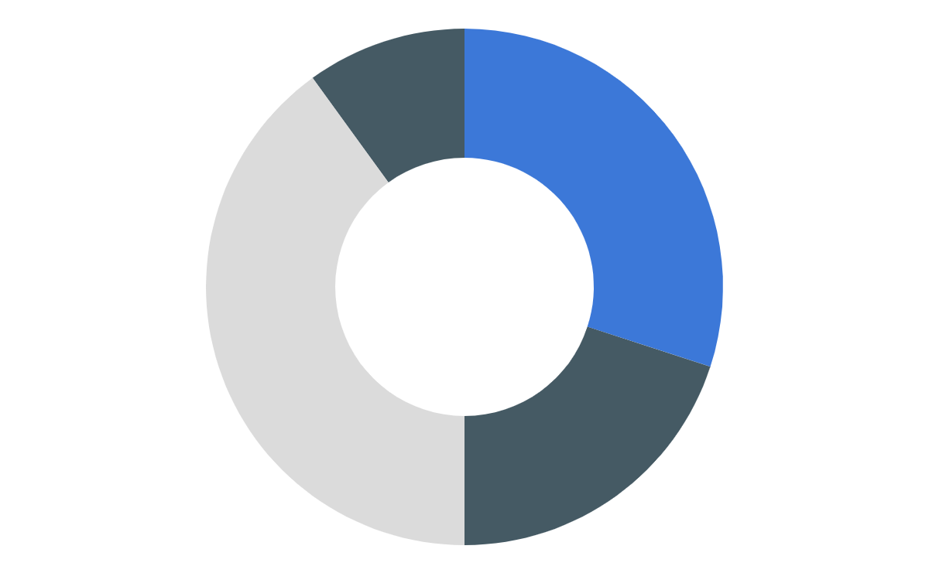
Budget
10%
30%
Area 1
Area 2
40%
20%
Area 3
Area 4
Mercury is the smallest planet
Jupiter is the biggest planet
Saturn is a gas giant and has rings
Earth is the planet we live on
To modify this graph, click on it, follow the link, change the data and paste the new graph here

Slide 14
Comparison of Budgets
 | Mass | Diameter | Surface
Area 1 | 0.06 | 0.38 | 0.38
Area 2 | 0.11 | 0.53 | 0.38
Area 3 | 95.2 | 9.4 | 1.16
Area 4 | 0.53 | 0.11 | 0.06

Slide 15
Project Goals
Goal 1
Goal 2
Despite being red, Mars is actually a cold place
Jupiter is a gas giant and the biggest planet
Goal 3
Goal 4
Yes, Saturn is the ringed one. It’s a gas giant
It’s the farthest planet
From the Sun

Slide 16
33,000.00
24h 37m 23s
386,000 km
earths is the Sun’s mass
is Jupiter’s rotation period
is the distance between Earth and the moon

Slide 17

A Picture Always Reinforces the Concept
Images reveal large amounts of data, so remember: use an image instead of long texts

Slide 18
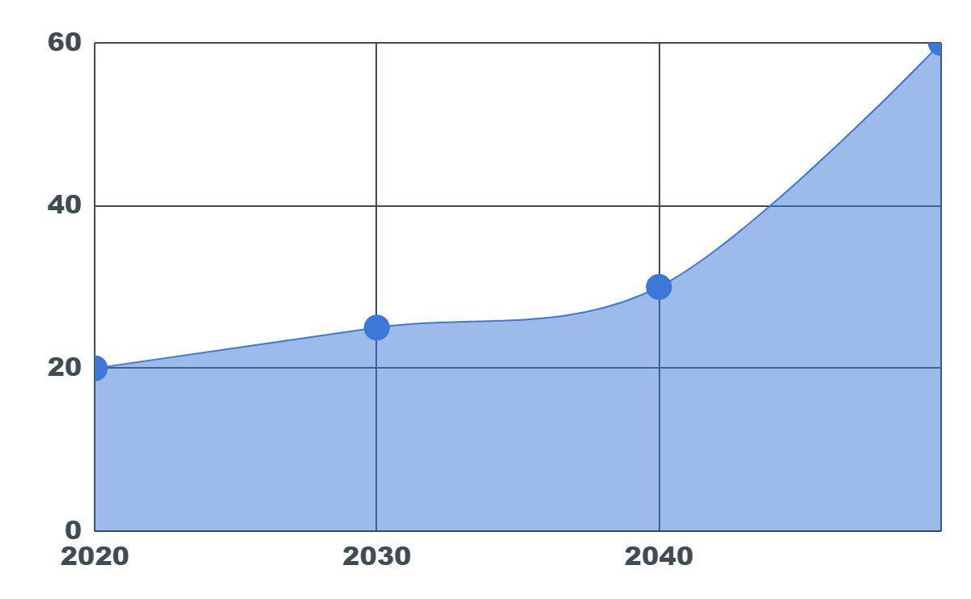
Predicted Results
To modify this graph, click on it, follow the link, change the data and paste the new graph here
You can write about the predicted results here
You can write about the predicted results here
You can write about the predicted results here
You can write about the predicted results here

Slide 19
Sneak Peak
04
You could enter a subtitle
here if you need it

Slide 20

Sneak Peek
You can replace the image on the screen with your own work. Right-click on it and choose "Replace image" so you can add yours

Slide 21
Sneak Peek
You can replace the images on these screens with your own work. Right-click on them and choose "Replace image" so you can add yours

Slide 22
Project Stages
Stage 2
Jupiter is a gas giant and the biggest planet
Stage 1
Yes, Saturn is the ringed one. It’s a gas giant
Stage 3
It’s the farthest planet from the Sun

Slide 23
Future Projects
Write your future project’s description here
Write your future project’s description here
Write your future project’s description here
Write your future project’s description here
Write your future project’s description here

Slide 24
Our Partners
Mars
Jupiter
Saturn
Despite being red, Mars is actually a cold place
Jupiter is a gas giant and the biggest planet
Yes, Saturn is the ringed one. It’s a gas giant

Slide 25
Timeline
Day 2
Day 4
Day 1
Day 3
Mercury is the smallest planet
Jupiter is the biggest planet
Saturn is a gas giant and has rings
Earth is the planet we live on

Slide 26
Thanks
Do you have any questions?
youremail@freepik.com
+91 620 421 838
yourcompany.com
Please keep this slide for attribution

